Slide 1
Integrating Environmental Considerations with Water Resource Simulations
Product Development Lead: Todd Steissberg (ERDC-EL)
Product Development Team:
Leila Ostadrahimi (HEC, Water Quality Lead)
Joan Klipsch (HEC, ResSim Lead)
Zhonglong Zhang (ERDC-LimnoTech)
Billy Johnson (LimnoTech)
Steve Andrews (RMA)
John DeGeorge (RMA)
Mark Jensen (HEC)
Corps District Collaboration:
Brian Zettle (SAM, CoP Lead, SON Proponent)
Alexis Mills (NWD)
Jeff Tripe (NWK)
Erich Emery (LRD)

Slide 2
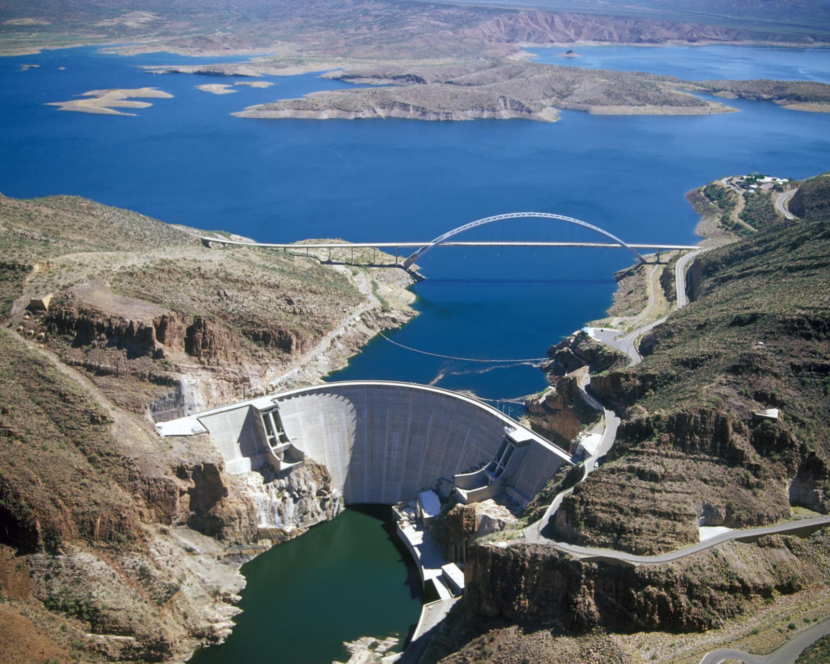

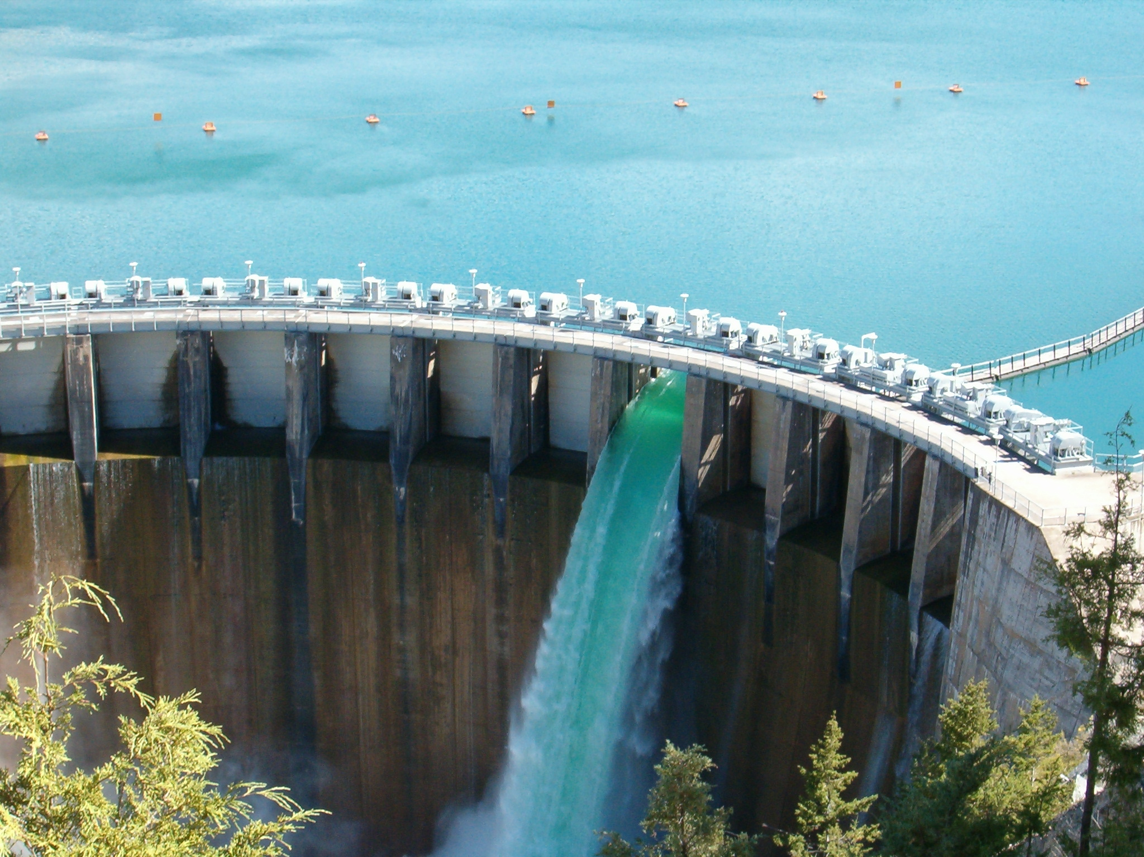
Project Purpose - Recap
SON: 2015-ER-5 Integrating Environmental Considerations with Water Resource Simulations
Need: Reservoir operations simulation software with the capability to fully integrate environmental objectives into reservoir release decision-making
Purpose: Integrate water quality modeling capabilities into HEC-ResSim, allowing water quality and related environmental objectives to directly inform reservoir release decision-making, while also providing capabilities for watershed-scale ecosystem assessment and management
Flows influence water quality
Water quality influences flows
Notes:
Keep it simple and clear. You may use a second slide if needed, however.

Slide 3
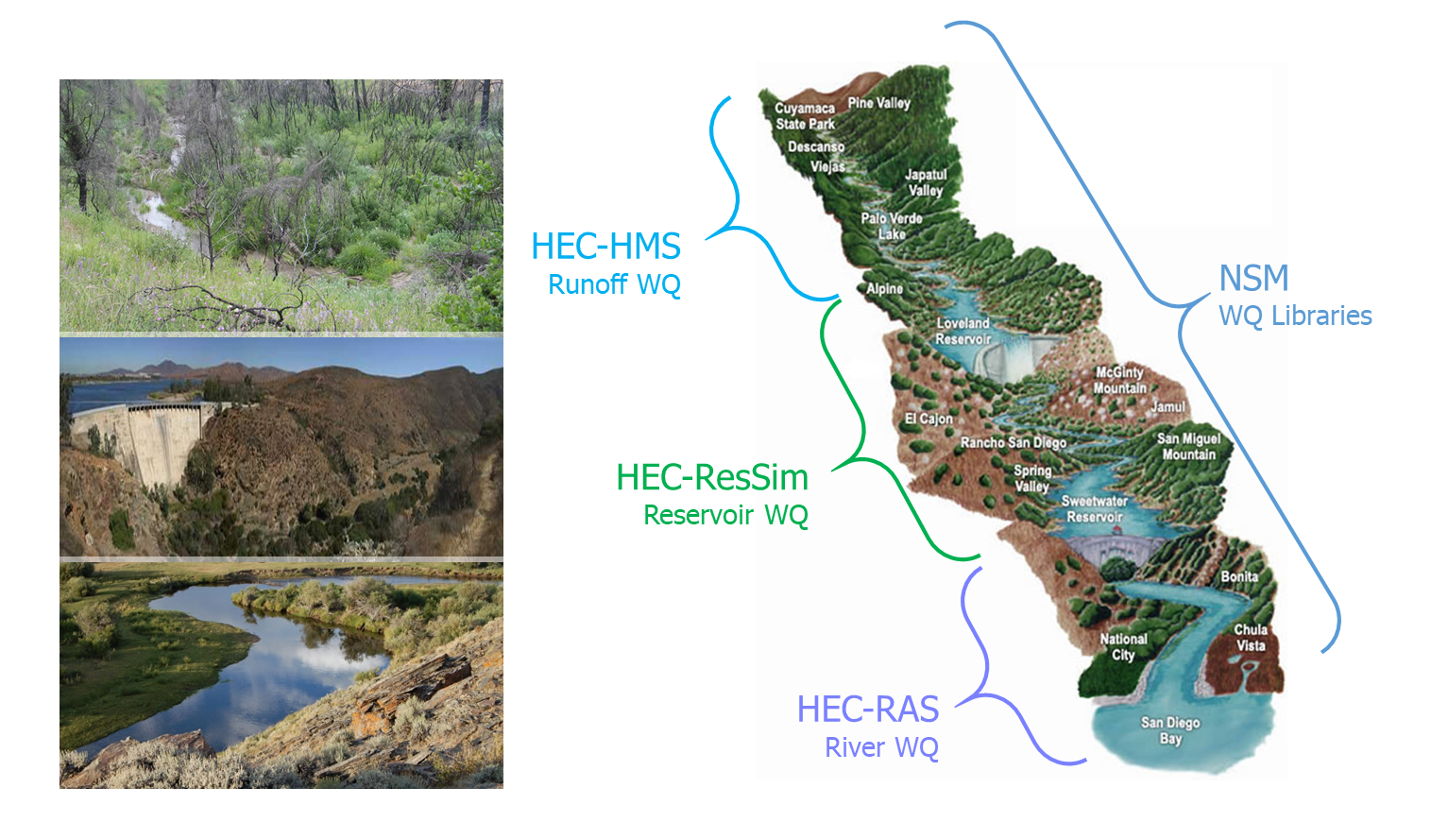
Integrated Watershed Water Quality Modeling
Temperature
Dissolved Oxygen
Primary Productivity
Nutrient Loading
Salinity
Related Analysis
Dilution
Water Age
Source Water Fingerprinting
Habitat Characterization
Models linked via:
CWMS: Real-time modeling
HEC-WAT: Planning studies

Slide 4
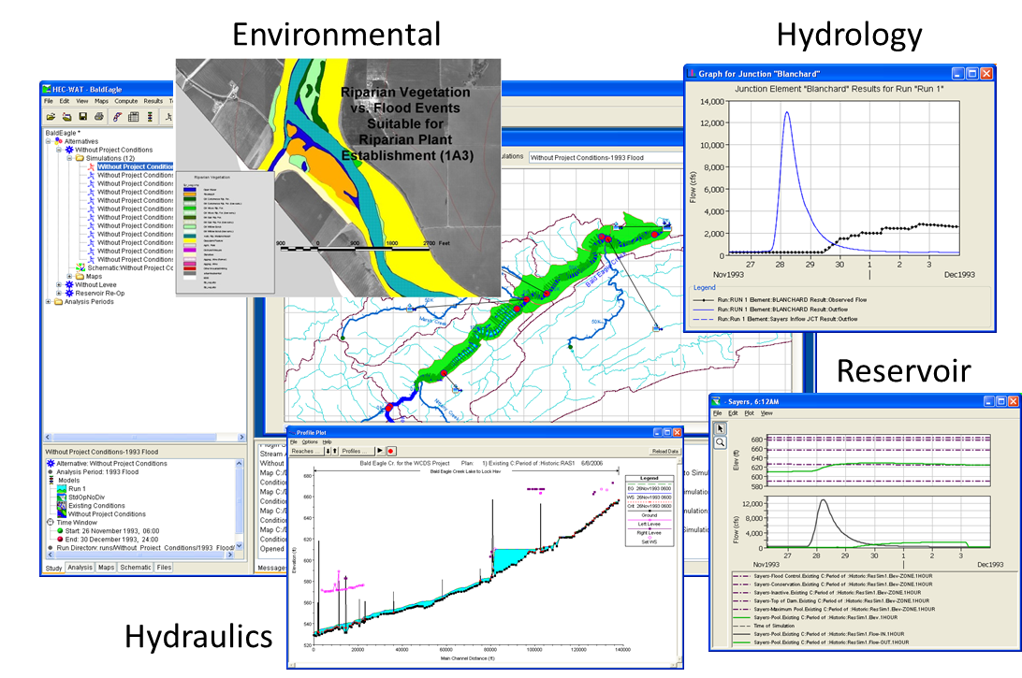
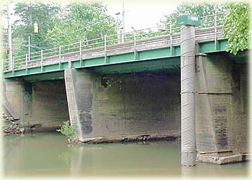
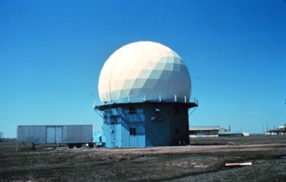
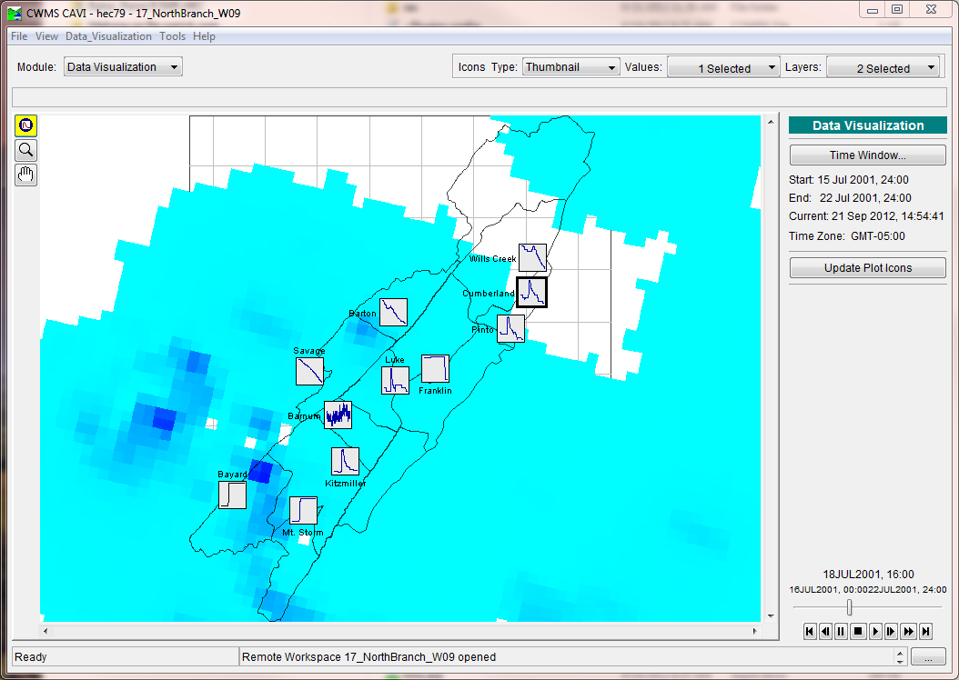
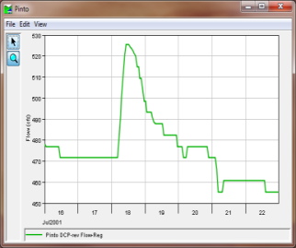
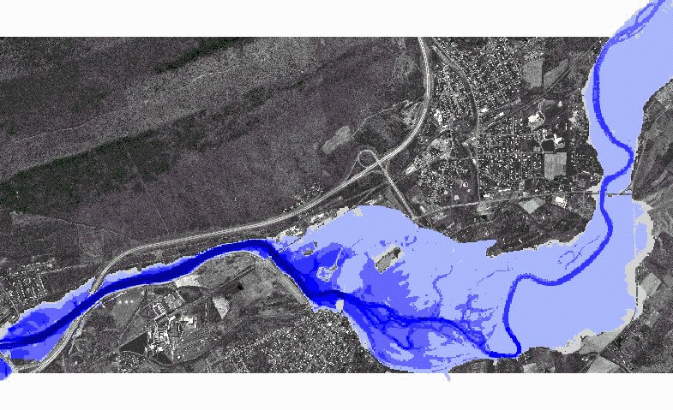
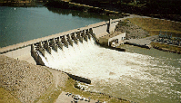
Integration Software for Planning and Real-Time Modeling
Planning Studies
HEC-WAT, Watershed Analysis Tool
Real-Time Operation
CWMS (Corps Water Management System)
HEC-RTS, Real-Time Simulation
Real-Time Fully Integrated
Hydrologic Models
Streamgage
Data
NWS
Forecasts
Inundation Mapping
Operational Decisions
www.hec.usace.army.mil/software/hec-wat/
https://www.hec.usace.army.mil/cwms/

Slide 5
Benefits
61%
HEC-ResSim is a widely deployed USACE-approved reservoir operations modeling program.
Users can compare multiple alternatives for planning studies.
ResSim is a critical part of the Corps Water Management System (CWMS) for real-time operation decision-making.
Impacts Assessment
Integrated WQ capabilities and graphics allow rapid, efficient, and effective environmental impacts assessment.
Environmental Flows
Users can create reservoir operation rules based on temperatures and constituent concentrations.
Rules based on flow or stage can be used in conjunction with WQ rules for ecosystem restoration and management (E-flows).
Selective withdrawal supports reservoirs with selective withdrawal structures.
Notes:
Keep it simple and clear. You may use a second slide if needed, however.

Slide 6
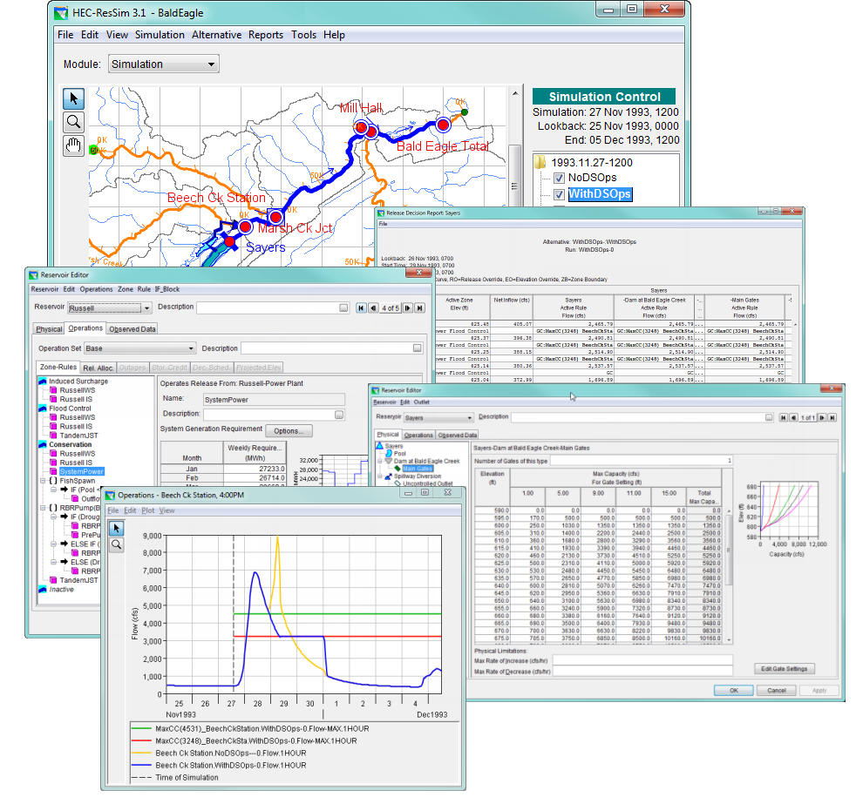
Approach
HEC-ResSim (Reservoir System Simulation) simulates reservoir operations at one or more reservoirs for:
Flood management
Low flow augmentation
Water supply
Applications:
Planning studies
Detailed reservoir regulation plan investigations
Real-time decision support
Notes:
Keep it simple and clear. Particularly with modeling efforts - the interaction of different models, modules and updates needs to be clear. Where in the grand scheme of things does this research fit?

Slide 7
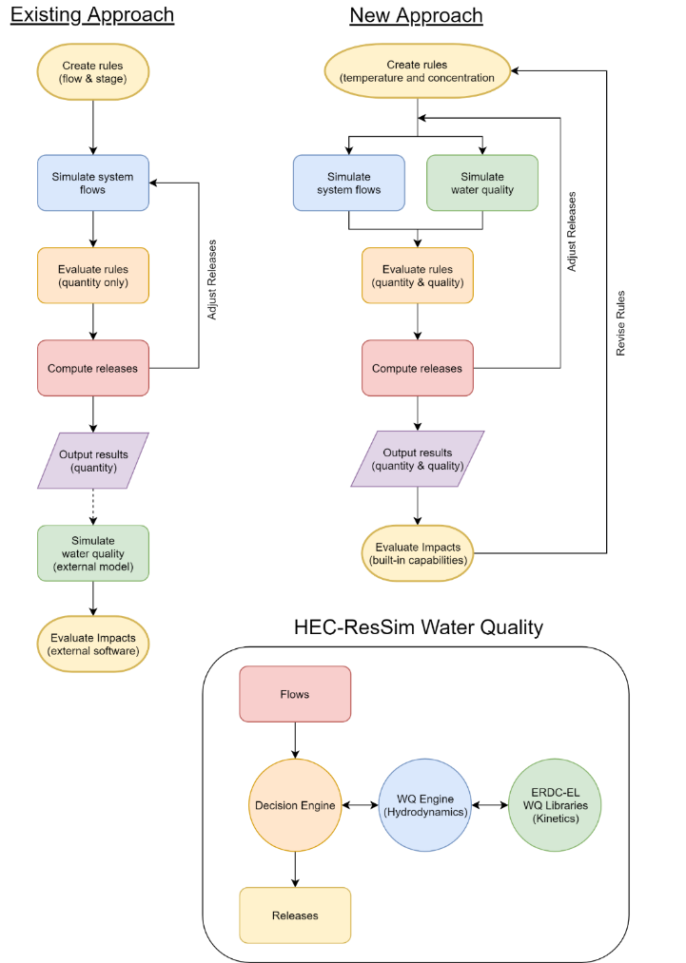
Approach
Existing Approach
WQ is simulated after computing the hydrology and release decisions.
WQ operation rules are specified indirectly (using stage and flow) to meet environmental objectives.
Environmental objectives are often combined with other objectives, like navigation, flood control, or hydropower.
If the desired environmental benefits of an alternative are not achieved, new guesses need to be made, and the simulation recomputed. This stage is often skipped altogether.
New Approach
WQ is simulated in parallel with the hydrology and release decisions
WQ operation rules can be specified directly (temperature, concentration, or load) to meet environmental objectives
Environmental objectives can be specified and managed independently of other objectives, clarifying the environmental impacts of operation decisions
(Manually)

Slide 8


Approach
Main Objective:
Build integrated one-dimensional (1D) water quality simulation and analysis capabilities for HEC-ResSim
Temperature
Eutrophication
Dissolved oxygen, nutrients, algae, etc.
General Constituents
Conservative and non-conservative
1D River
1D Reservoir
u
x
x
z

Slide 9
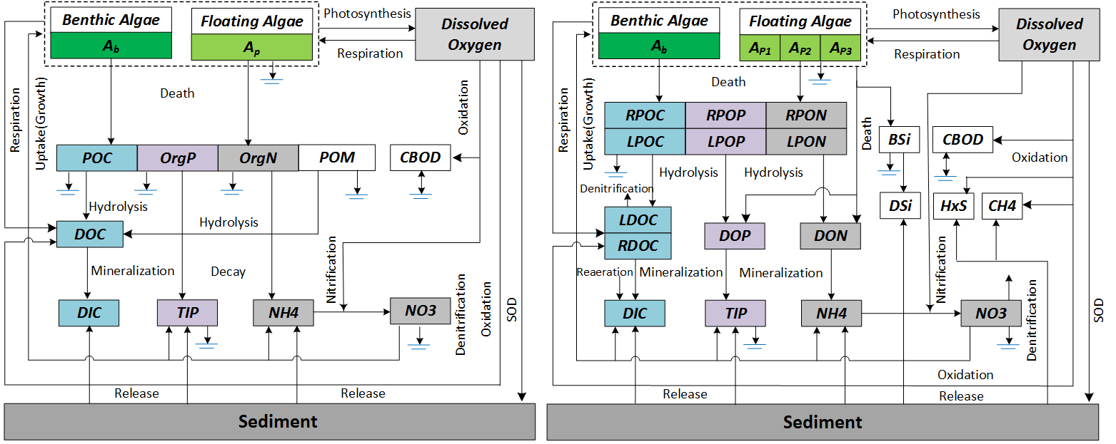
Approach
ClearWater Engine and Modules (Computational Library for Environmental Analysis and Restoration of Watersheds) :
ClearWater Water Quality Engine:
Hydrodynamics and transport
Communication with ResSim decision engine & WQ libraries
ClearWater Water Quality Modules:
Simulate vertically stratified water column
Plug-in interface for kinetics libraries:
Facilitate rapid future expansion of WQ capabilities
Leverage existing software:
ClearWater Modules (Temperature, nutrients, etc.)
CE-QUAL-W2
HEC-RAS
HEC-5Q
Notes:
Include all PRODUCTS/DELIVERABLES as specified in the original WU documentation

Slide 10
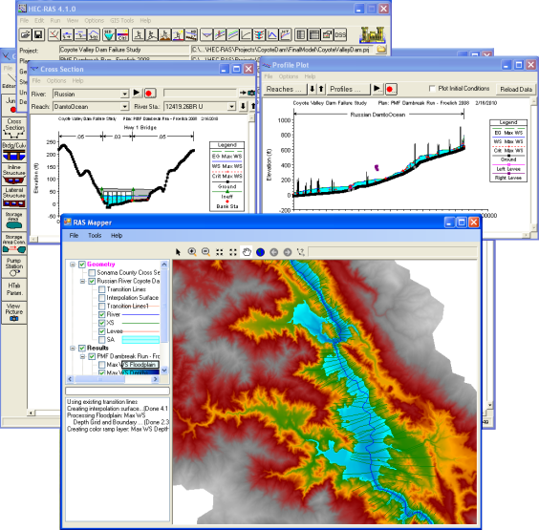
Approach
User Interface:
Extends ResSim user interface for WQ
Leverages existing capabilities:
HEC-ResSim:
Plots
Reports
Schematic
Operating rules
Hydrology
HEC-RAS:
Meteorology and WQ stations
WQ plots
WQ cells

Slide 11
Field Engagement
Project Planning
Team meetings and conference calls
Periodic project updates to PDT, ERARG members, and field personnel by phone, web meeting, and email
Reporting
Quarterly updates to:
Corps Water Quality Committee
Field Work Coordination
Coordination with NWD (Alexis Mills, Dan Turner, Kathryn Tackley):
Added Total Dissolved Gas capabilities to water quality modules in support of the Columbia River System Operation Environmental Impact Statement study (FY17 – FY18)
Collaborated with J.J. Baum, Terra Salamida, and Nancy Lam (SPK)
Software and model development and testing
Notes:
Include all PRODUCTS/DELIVERABLES as specified in the original WU documentation

Slide 12
Scheduled Products
Scheduled Products
Description | Scheduled Due Date | Current Percent Complete | Projected Completion Date
 | (Qtr/Yr) | (%) | (Qtr/Yr)
1. Water quality software design document | Q4/FY16 | 100 | Q4/FY16
2. HEC-ResSim unit test program with 1D water quality capabilities (temperature, conservative constituent, and eutrophication) | Q4/FY17 | 100 | Q4/FY17
3. EL Water Quality libraries developed and ready to link with HEC-ResSim to provide eutrophication simulation capability (DO, nutrients, etc.) | Q3/FY17 | 100 | Q3/FY17
Notes:
Describe product and capability, importance/impact, etc.. Employ images generously. Tell a good story.

Slide 13
Scheduled Products
Scheduled Products
Description | Scheduled Due Date | Current Percent Complete | Projected Completion Date
 | (Qtr/Yr) | (%) | (Qtr/Yr)
4. Beta version: HEC-ResSim with full (temperature and eutrophication) 1D water quality simulation and analysis capabilities | Q3/FY18 | 100 | Q1/FY20
5. Software tested and ready to deploy | Q4/FY18 | 100 | Q4/FY20
6. Software documentation (user’s manual and applications guide) prepared | Q4/FY18 | 100 | Q4/FY20
Notes:
Describe product and capability, importance/impact, etc.. Describe product and capability. Employ images generously. Tell a good story.

Slide 14
Scheduled Products
Scheduled Products
Description | Scheduled Due Date | Current Percent Complete | Projected Completion Date
 | (Qtr/Yr) | (%) | (Qtr/Yr)
7. Deployment Version: HEC-ResSim with full (temperature and eutrophication) 1D water quality simulation and analysis capabilities, with documentation, posted to HEC and ERDC-EL websites | Q2/FY19 | 100 | Q4/FY21
8. Technical Transfer: Two-day water quality modeling workshop Webinar demonstrations and working sessions | Q2/FY19 | 100 | Q4/FY20
9. Technical Transfer: Documentation posted to HEC and EL websites; reports and papers prepared | Q2/FY19 | 100 | Q4/FY20
Notes:
Describe product and capability, importance/impact, etc.. Describe product and capability. Employ images generously. Tell a good story.

Slide 15
Additional Products/Achievements
Additional Products/Achievements
Description | (Qtr/Yr)
1. Development of total dissolved gas (TDG) capability for NWD Columbia River NEPA analysis | Q3/FY17
2. HDF5 interface libraries built that can be used with Fortran, .Net (Visual Basic and C#), and Java. These libraries provide a user-friendly interface for exchanging data with HDF5 files. These general-purpose libraries can be used by HEC-ResSim, HEC-RAS, HEC-HMS, and other programs to store and retrieve hydrologic and environmental data. | Q4/FY17
3. Collaboration established with Sonoma County Water Agency (SCWA) to complete development of shared WQ engine. SCWA will provide funding for WQ engine development and then apply HEC-ResSim for their Russian River WQ study in FY19. | Q4/FY18
Notes:
Funding for all FY’s funded

Slide 16
Additional Products/Achievements
Additional Products/Achievements
Description | (Qtr/Yr)
4. Set of water quality web pages have been created that provide an overview of the ERDC-HEC collaboration and water quality software being developed under this work unit, other EMRRP work units, and with District funding and collaboration. Web pages include summaries of ERDC-EL NSM and RVSM modules, water quality capabilities being developed in HEC-RAS, HEC-ResSim, and HEC-HMS, in addition to technical references, sponsors, collaborators, and instructions for users to submit feedback/suggestions for improvements. Web Address: https://www.hec.usace.army.mil/software/waterquality/ | Q2/FY19

Slide 17
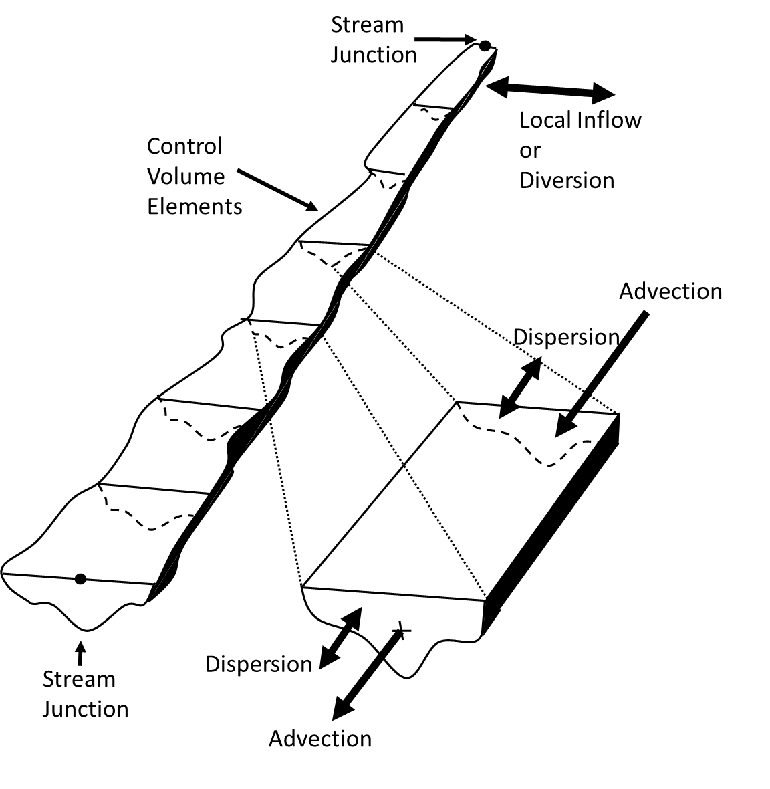
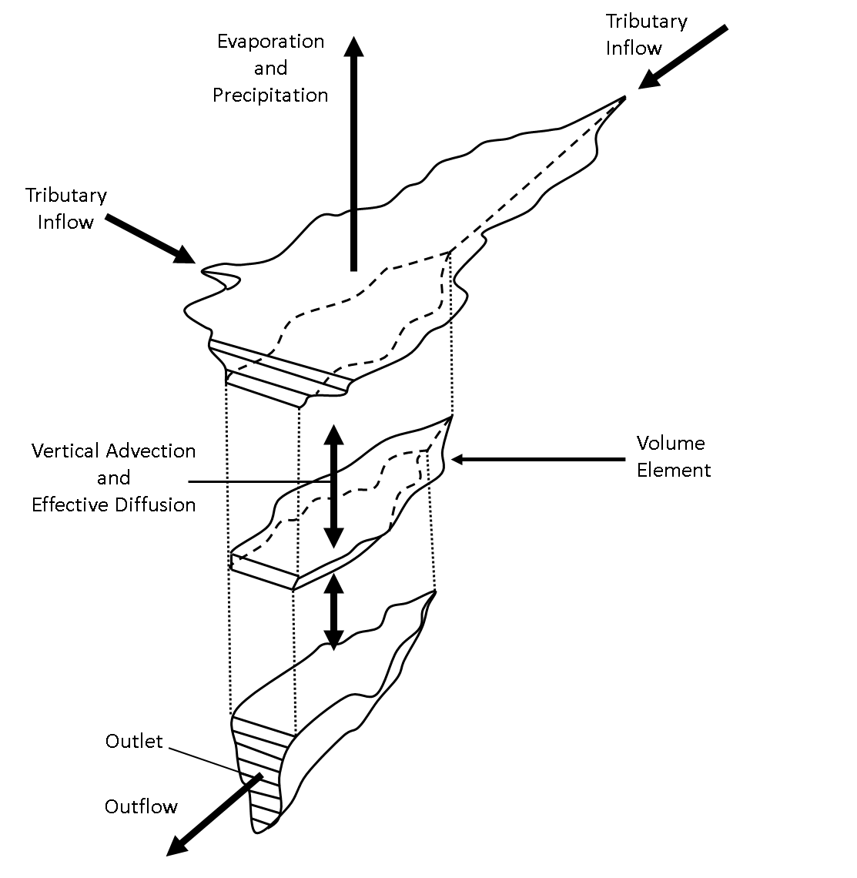

FY 16 - 21 Accomplishments Water Quality Transport Engine
$$\underset{\begin{aligned}\text{time} \\ \text{derivative}\end{aligned}}{\underbrace{\frac{∂C}{∂t}}}+ \underset{\text{advection}}{\underbrace{\frac{∂\left(vC\right)}{∂x}}} = \underset{\text{diffusion}}{\underbrace{\frac{∂}{∂x}\left(K\frac{∂c}{dx}\right)}} + \text{sources}\text{/}\text{sinks}$$
Finite Volume Numerical Scheme
1D river reach with junctions
1D vertically stratified reservoir
Explicit solution scheme with sub-stepping
Cell face concentrations determined with 1st order upwind method, 2nd order flux-limiting method in testing.
Accept flows computed by hydraulic or hydrologic routing
(1D)
1D Reach
RMA, “Generalized One-Dimensional Reservoir and River Water Quality Engine Prototype”, prepared for the USACE Hydrologic Engineering Center, November 2017
1D Reservoir

Slide 18
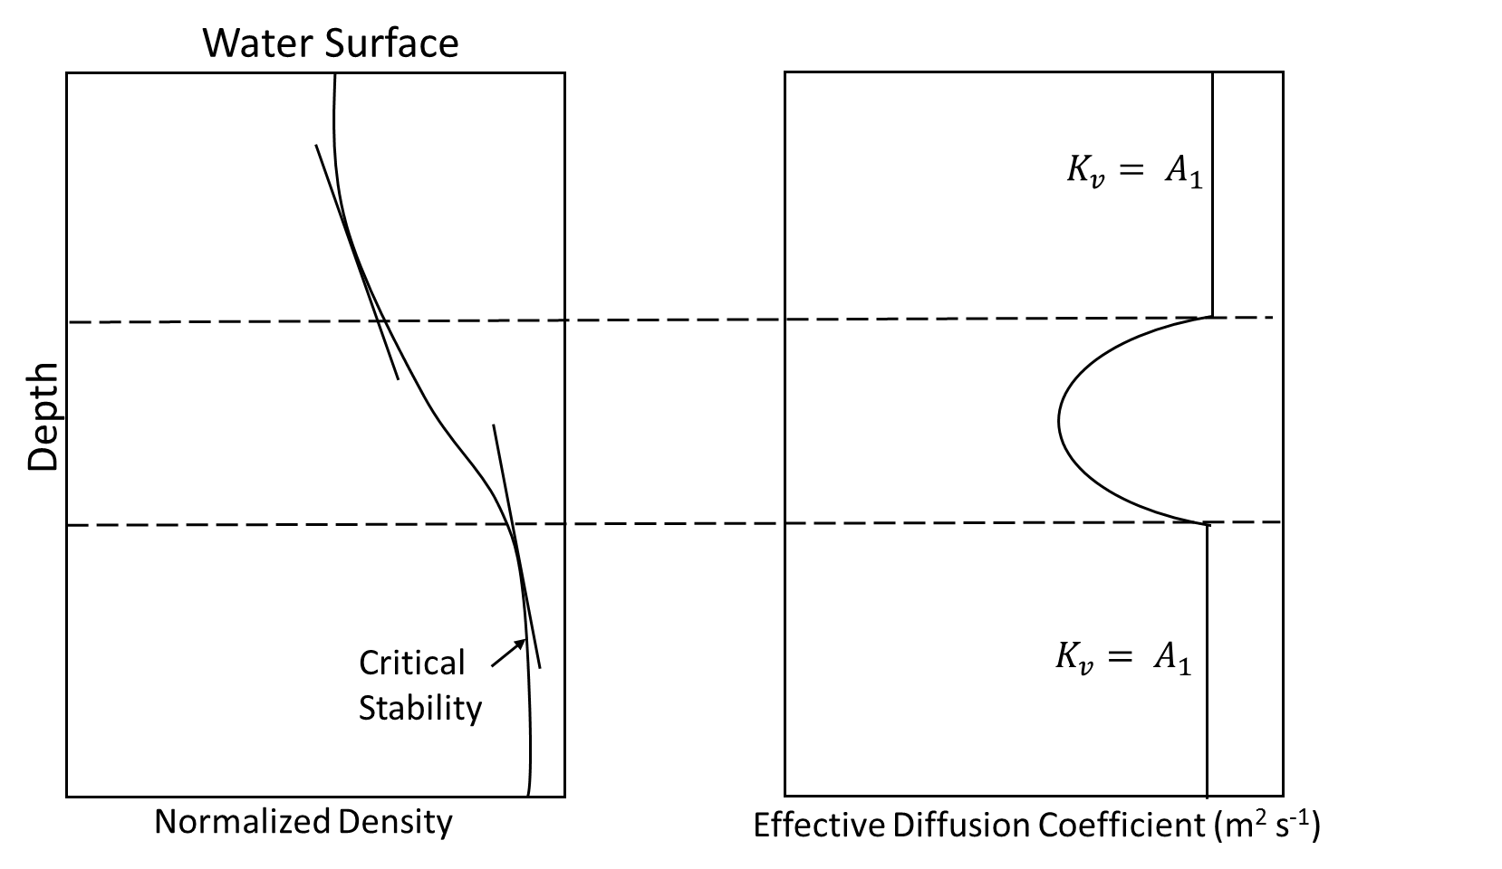
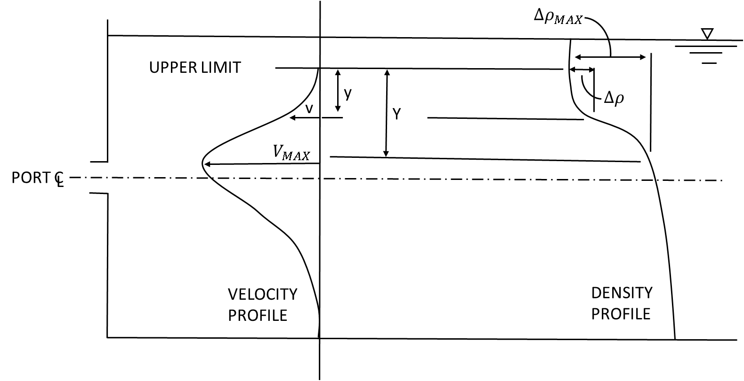
FY 16 - 21 Accomplishments Density-Stratified Reservoirs
Vertical Diffusion and Mixing Layers
Vertical diffusion and layer stability related to surface wind and density gradient, which is in turn a function of temperature, salinity, or suspended solids
Inflow Allocation
Determine reservoir layer with density equal to inflow density
If in upper or lower mixed zones (epilimnion or hypolimnion), distribute over zone
If in stratified zone, determine thickness of inflow zone
Withdrawal Allocation
Layers from which water is withdrawn is a function of the outlet elevation and size, density distribution, and flow rate
Methodologies adapted from HEC-RAS WQ beta, ERDC CE-QUAL-R1, CE-QUAL-W2, and HEC5Q
u
x
z

Slide 19
FY 16 - 21 Accomplishments

Slide 20
FY 16 - 21 Accomplishments

Slide 21
FY 16 - 21 Accomplishments

Slide 22
FY 16 - 21 Accomplishments

Slide 23
FY 16 - 21 Accomplishments

Slide 24
FY 16 - 21 Accomplishments

Slide 25
FY 21 Accomplishment Technical Transfer
The National Conference on Ecosystem Restoration (NCER), Virtual, July 2021
Organized two sessions:
Water Quality Modeling Software Development
Water Quality Modeling Applications/Studies
Abstract accepted, American Geophysical Union (AGU) Conference, December 2021

Slide 26
Synopsis
Funding
FY16 $300K
FY17 $300K
FY18 $300K
FY19 $300K
FY20 $50
Project $1,250K
Project Status
Pre-release version complete
Minor updates to software and documentation
Final version delayed until Q4/FY21 due to IDIQ contract award delay
Project Focus
ResSim WQ capabilities have been implemented
Other Comments
Collaborating with HEC-HMS team on shared WQ engine development
Additional development and support is being funded by the Sonoma County Water Association (SCWA) for the Russian River Study
$1M anticipated from USBR in FY21 to replace their HEC-5Q models with ResSim WQ. This would fund additional development and modeling.

Slide 27
Summary
Water quality capabilities have been implemented in HEC-ResSim.
ClearWater Engine
Temperature and eutrophication modeling capabilities
User Interface for model setup, data input/output, visualization/analysis of results
Release version is being used to prepare documentation, software demos, and water quality modeling workshop.
Workshop was replaced with demonstrations and working sessions:
Due to time constraints and travel restrictions, field users requested periodic follow-up demonstrations (1-2 hours) instead of a workshop.
District partners suggested that an in-person or virtual working session be scheduled prior to initiating a WQ modeling project.

